Slide 1
Integration Test Patterns
I4SWT

Slide 2
Integration test
Requirements
Accept testing
System specification
System testing
System design
Integration testing
Component design
Unit test
Implement component

Slide 3
Challenges
As we progress ”up the V” (and towards the complete system), …
Defining a test strategy
Defining test cases
Evaluating test results
Setting up test fixtures
Setting up test scenarios
Ensuring test coverage
Version-controlling tests
…all become more difficult, expensive, time-consuming – and important!

Slide 4
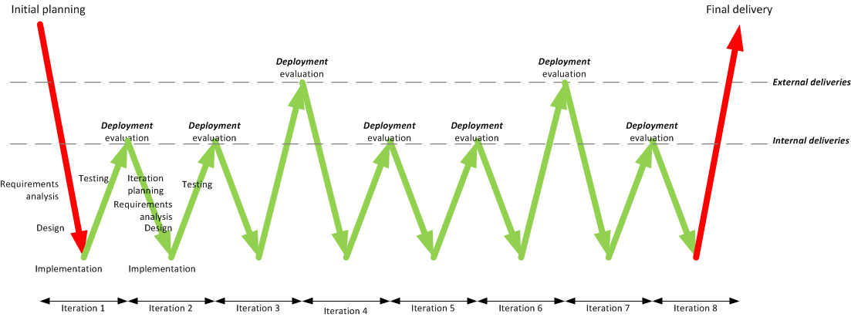
Integration test in an iterative process
IT
IT
IT
IT
IT
IT
IT

Slide 5
Lecture plan
This lecture
Theory of integration test patterns
Find the dependency tree
Next lecture
Integration Test Planning
Integration Test Case Generation
IT and CI

Slide 6
Purpose, aim

Slide 7
Purpose, aim
The purpose of integration test is to test the interactions and interfaces between several modules
The aim is to verify correct interaction of the tested modules
Classes
Packages
Components
Subsystems
Additionally – the interaction between the low level modules (HW drivers) and the actual hardware: that is hardware-software integration
Verification requires 100% interface coverage – is hard to measure and can be hard to obtain

Slide 8
Being smart about integration tests
Integration tests are linked to project ”heartbeat”
Integration testing usually requires input from several partners, so test planning becomes key.
Large-scale component integration (at least) at the end of each iteration.
Integration tests requires knowledge of system architecture to partition the system into testable chunks
A strategy!
And a plan!

Slide 9
Prereq’s for starting integration test
Unit testing of all modules is complete
System architecture (dependencies) is known
Integration test plan is defined
Integrated modules
System Under Test (SUT) structure?
Test fixtures / environment
Test cases – SUT stimuli and expected responses

Slide 10
Getting ready – mapping the dependency tree
Integration test planning is helped along using a dependency tree
Depicts inter-module dependencies in a tree-like structure
Does not depict an inheritance hierarchy, layering or the like
A depends-on B, C and D
B depends-on E and F
C depends-on F and G
D depends-on H and I
Some dependencies are obvious from sequence diagrams, object diagrams, state charts, etc.
Others require inspection (members, parameter types, ..)
Loops must be broken using stubs

Slide 11
Integration test patterns
Integration test patterns are used to plan and execute the integration tests.
This session covers the following patterns
Big Bang Integration
Bottom-up Integration
Top-down Integration
Collaboration Integration
Sandwich Integration

Slide 12
Big Bang Integration

Slide 13
Big Bang Integration
”Fire it up, see it fail”
Works (sometimes) for small, low-complexity, stable, systems
Only possible late in
development –
errors costly to fix
Works (sometimes) for small, low-complexity, stable, systems
Very low probability of detecting errors
Very little feed-
back

Slide 14
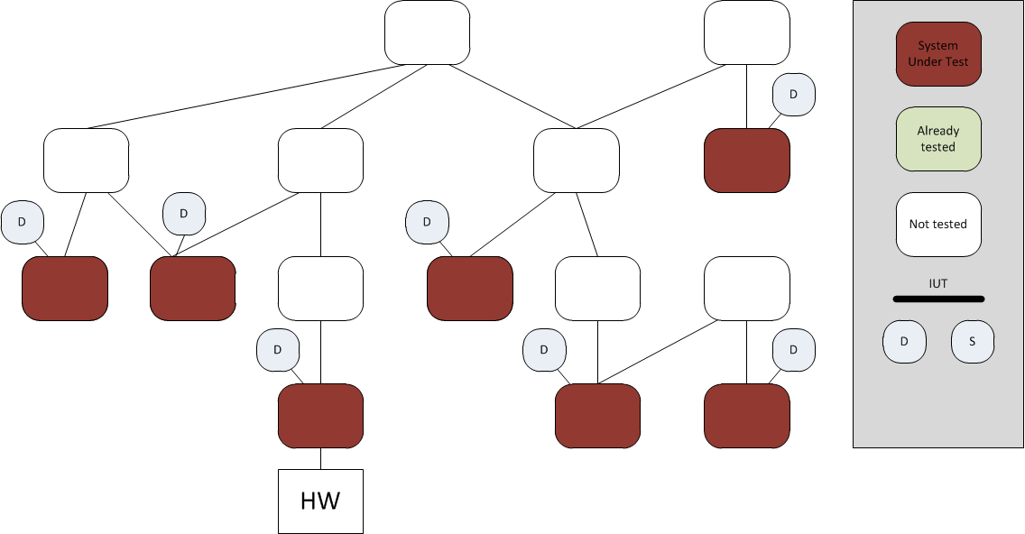
Bottom-up Integration

Slide 15
Bottom-up Integration

Slide 16
Bottom-up Integration

Slide 17
Bottom-up Integration

Slide 18
Bottom-up Integration

Slide 19
Bottom-up Integration
Reflects very ”engineering-like” mindset
No (few) stubs to develop
Requires many drivers at different levels
Easy to cover interfaces at all levels
Postpones test of critical control com-ponent interfaces

Slide 20
Top-down Integration

Slide 21
Top-down Integration

Slide 22
Top-down Integration

Slide 23
Top-down Integration

Slide 24
Top-down Integration

Slide 25
Top-down Integration
Needs lots of stubs (OK with isolation framework)
Early feedback on controller compo-nents
Hard to exercise low-level interfaces from the top
Facilitates concurrent HW and SW development

Slide 26
Collaboration Integration

Slide 27
Collaboration Integration

Slide 28
Collaboration Integration

Slide 29
Collaboration Integration

Slide 30
Collaboration Integration

Slide 31
Collaboration Integration

Slide 32
Collaboration Integration
Needs lots of stubs (OK with isolation framework)
Intuitive for users (may follow use cases)
Hard to exercise low-level interfaces
Participants not exercised separa-tely – mini Big-Bang!
Especially useful for higher-level system tests (component, subsystem)
Models iterative development with UCs as unit

Slide 33
Sandwich Integration

Slide 34
Sandwich Integration

Slide 35
Sandwich Integration

Slide 36
Sandwich Integration

Slide 37
Sandwich Integration

Slide 38
Sandwich Integration

Slide 39
Sandwich Integration
Takes lots of planning
The best of top down and bottom up
Many of the disadvantages of TD and BU are alleviated

Slide 40
Best practices
Automate, automate, automate
Higher complexity → lower probability
Use High Frequency integration: Nightly CI builds for each test scenario to check integration (common code repo)
Use Unit Test and isolation frameworks as much as possible
Easier to code stubs than drivers
Use a little bit of all patterns (except Big Bang)

Slide 41
Integration test with Continuous Integration
IT
IT
IT
IT
IT
IT
IT
IT
IT
IT
IT
IT
IT

Slide 42
Step 1 – Find the Dependency tree!
Class diagrams (static information)
Remember polymorphic classes
Sequence diagrams (behavioral information)
Test cases for units
Which interfaces were defined
Which IFs were faked
Call trees? Manually or automated tool?
Reveals "tool classes", objects passed around
Dependency tree generator tool?

Slide 43
Exercise
Find the dependency tree for the Microwave Oven System that is the material for Hand In nr. 2.
Look for dependencies using the list on the previous slide
Remember – it is the actual code/modules/classes that must be integrated!

